Slide 1
MHS
May 2019
Teaching and Learning

Slide 2
The Donaldson Report (2015)
Wales’ vision of the Welsh learner – 4 core purposes:
ambitious, capable learners, ready to learn throughout their lives
enterprising, creative contributors, ready to play a full part in life and work
ethical, informed citizens of Wales and the world
healthy, confident individuals, ready to lead fulfilling lives as valued members of society.

Slide 3
The Review proposes six Areas of Learning and Experience, as follows:
Expressive arts;
Health and well-being;
Humanities;
Languages, literacy and communication;
Mathematics and numeracy;
Science and technology.

Slide 4
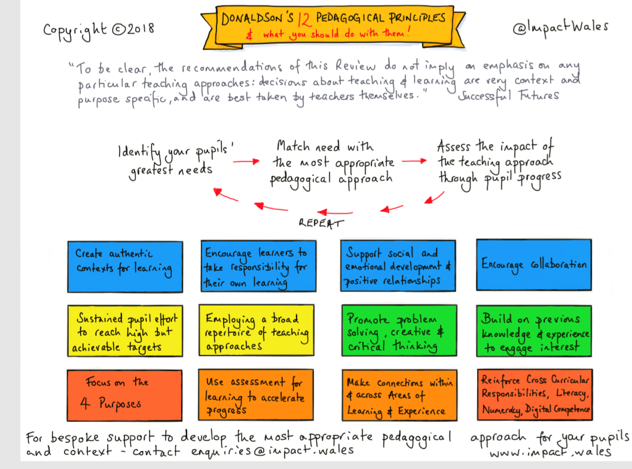
12 Pedagogical Principles:

Slide 5
Assessment FOR Learning Making FEEDBACK meaningful

Slide 6
Self/Peer-Assessment
Self and Peer Assessment: Self and peer assessment are important aspects of ‘assessment for learning’ practice. Assessing their own work or that of others can help students to develop their understanding of the Intended Learning Outcomes and the Assessment Criteria. Research has shown that learners make more progress when they are actively involved in their own learning and assessment.
Self-assessment “is the involvement of students in identifying standards and/ or criteria to apply to their work, and making judgments about the extent to which they have met these criteria and standards…..[it] means more than students grading their own work; it means involving them in the process of determining what is ‘good work’.”
Adapted from Boud, D. (1995) Enhancing Learning through Self-Assessment; Kogan Page; London

Slide 7
Self and Peer-Assessment will:
• Enhance students’ active engagement with their studies and encourage deeper learning, through more thorough engagement with success criteria. • Increase the amount and frequency of feedback students receive.
• Augment learning, as peer feedback invariably requires explanation and justification. Also, in some cases, students respond better and engage more fully with the feedback they get from their peers. • Help students understand what is considered good work and why.

Slide 8
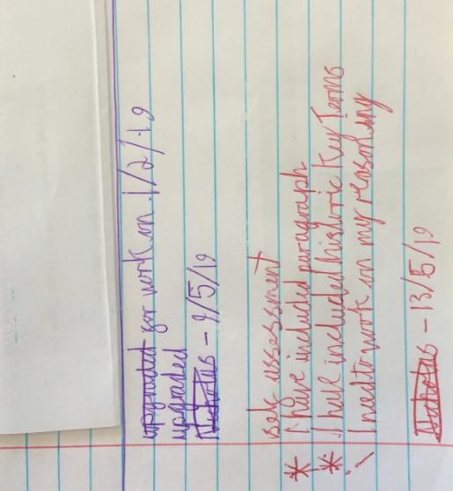
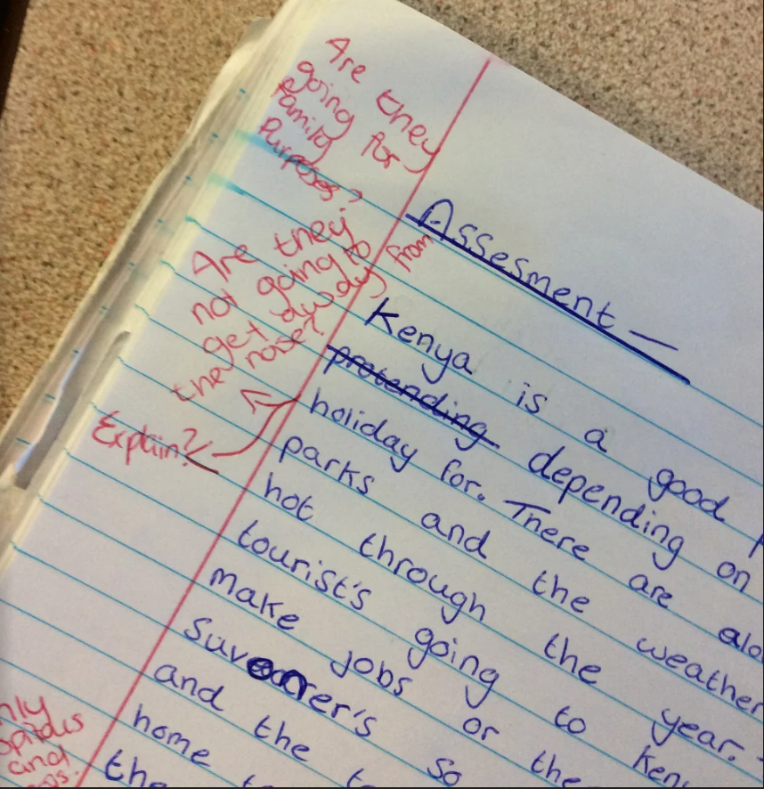
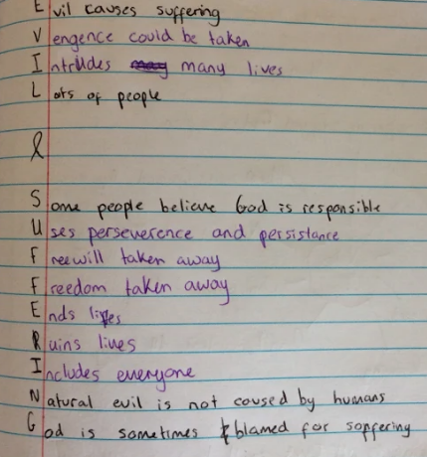

Slide 9
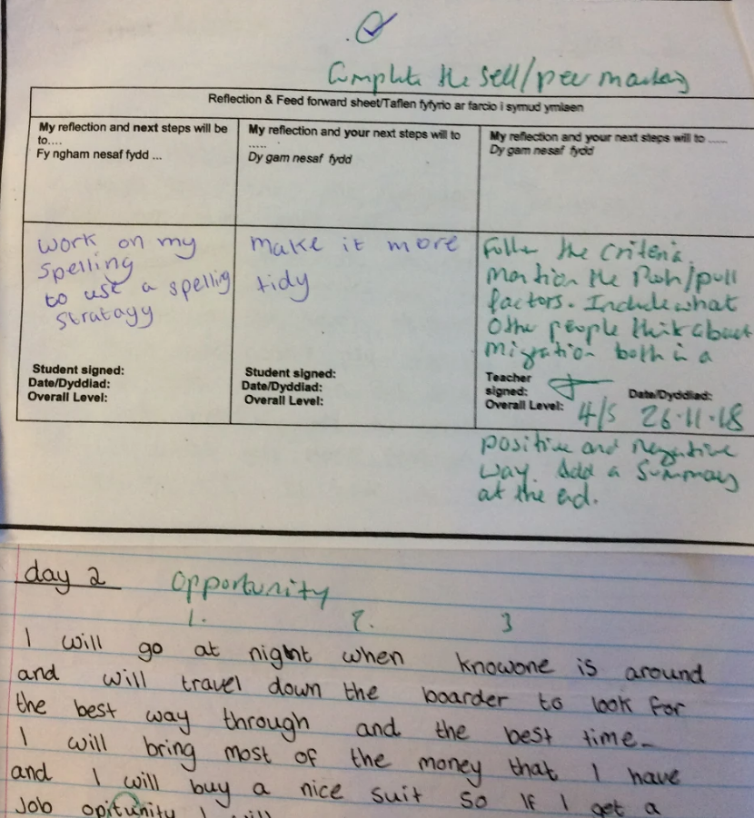
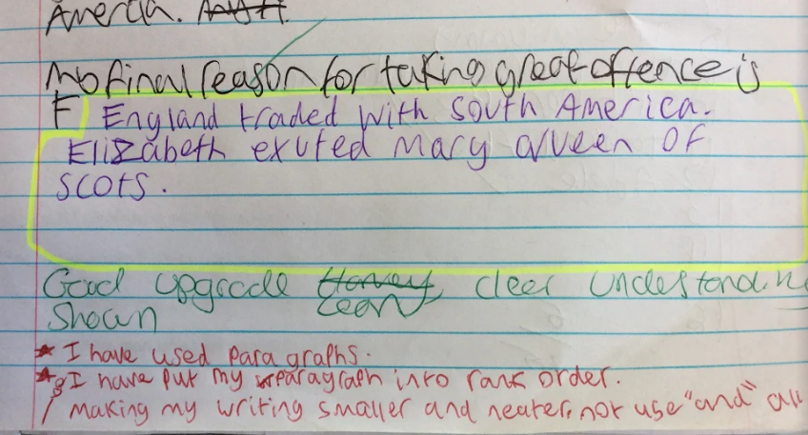

Slide 10
Work Scrutiny
Every half term, pupils’ work is assessed by Middle and/or Senior Leaders.
Pupils’ work and teachers’ feedback is assessed against a set of criteria.
The criteria has been taken from the school’s priorities – Estyn report, PIAP (Post Inspection Action Plan), SIP (School Improvement Plan).
It also includes AFL principles, including setting success criteria, self/peer assessment, teacher assessment, setting an ‘actionable’ next steps task (target) and pupils completing the target.

Slide 11
Feedback and Follow-Up:
Staff receive feedback on their work.
Curriculum Leaders receive feedback on everyone in their department.
Targets are set for individuals, departments and as a school.
Targets are followed-up the following half term.

Slide 12
Current Targets:
Teachers must set ‘actionable’ targets on the blue slips
Pupils must be given DIRT (Dedicated Improvement Reflection Time) to achieve the target set asap
Pupils complete the target and level sheet in the front of their book
More extended writing opportunities, less worksheets
Self/Peer-assessment (red pen) - 2 strengths and one area to improve from the success criteria then pupils make the amendment

Slide 13
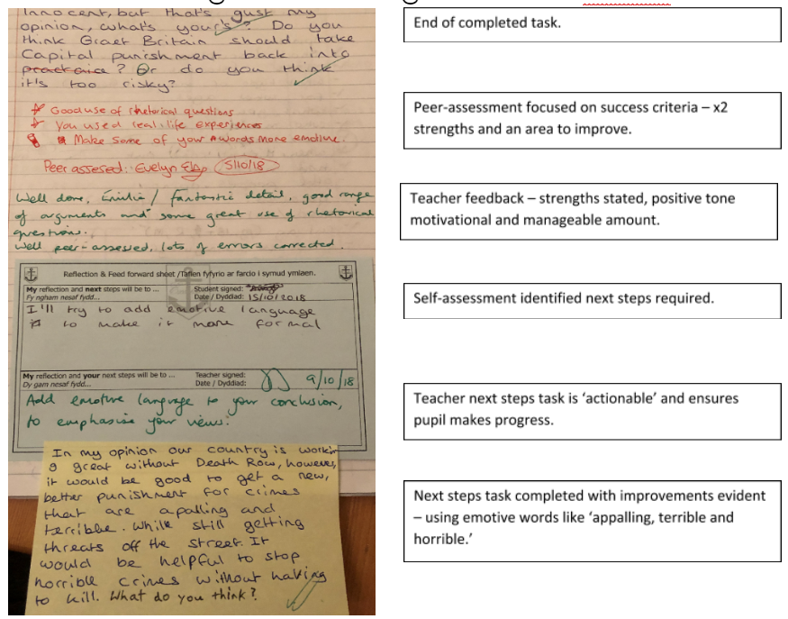

Slide 14
Homework
Variety set, depending on the department and their requirements:
Some subjects set menus – choice
Some set regular weekly homework
Some departments set ‘follow-up’ tasks when required
Food Tech - weighing and measuring ingredients at home, in Product Design it could be research a task( this could once in the rotation), in Metal it could be flipped lesson on watching a process
Research for oracy tasks
Daily practise on a musical instrument

Slide 15
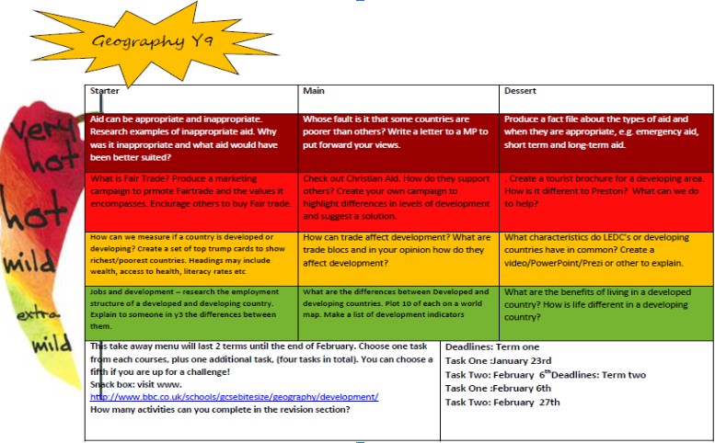

Slide 16
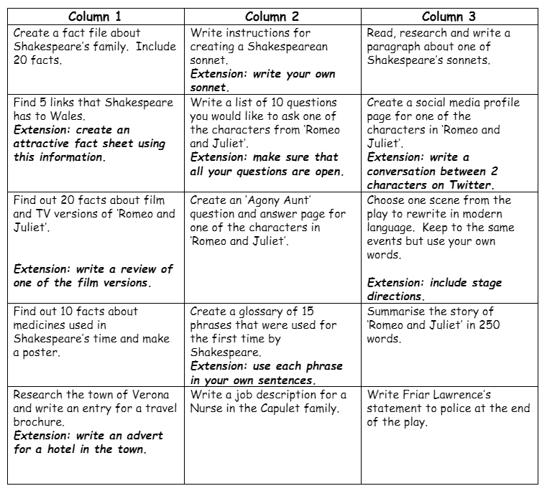
Romeo & Juliet Yr9 English

Slide 17
Every day homework
Revise/read over work
Read – fiction, non-fiction
Complete ‘next steps’ tasks after work has been marked
Complete Literacy corrections
Summer Term staff PLC:
Review whole school homework policy

Slide 18
Any questions?

